Slide 1
Responsive Design
Sean Prendi and JJ Cheng

Slide 2
What Is Responsive Design
Designing a webpage capable of fitting to any user’s screen

Slide 3
How Do You Design a Responsive Webpage?
Simplicity When Possible
Adaptive Components
Adaptive Layout

Slide 4
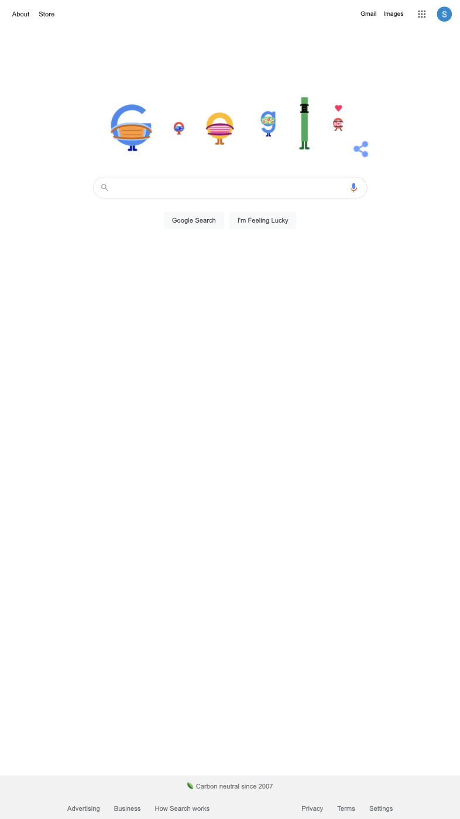
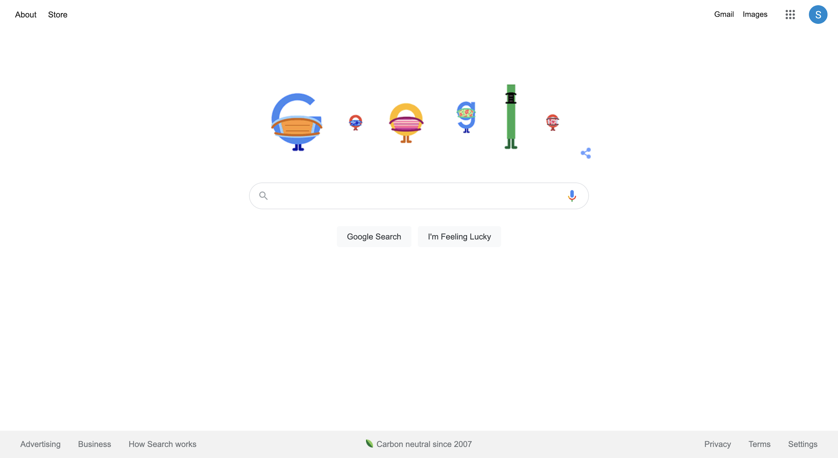
Simplicity When Possible
A simple page is a responsive page.

Slide 5
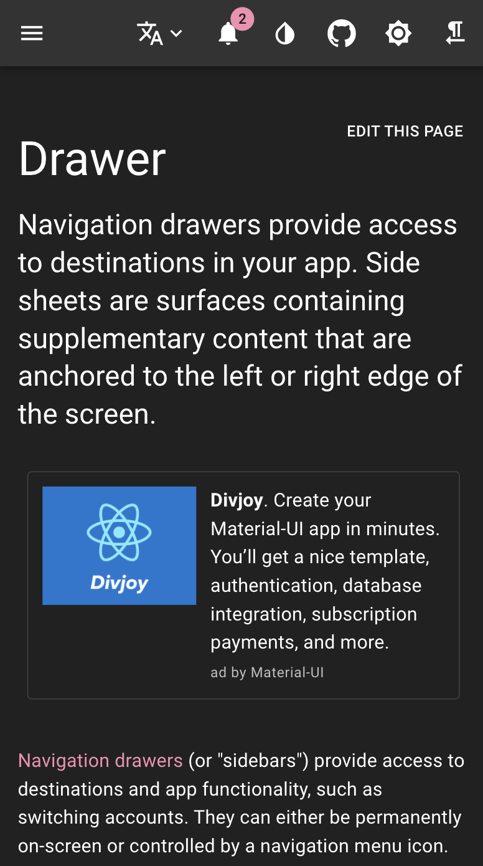
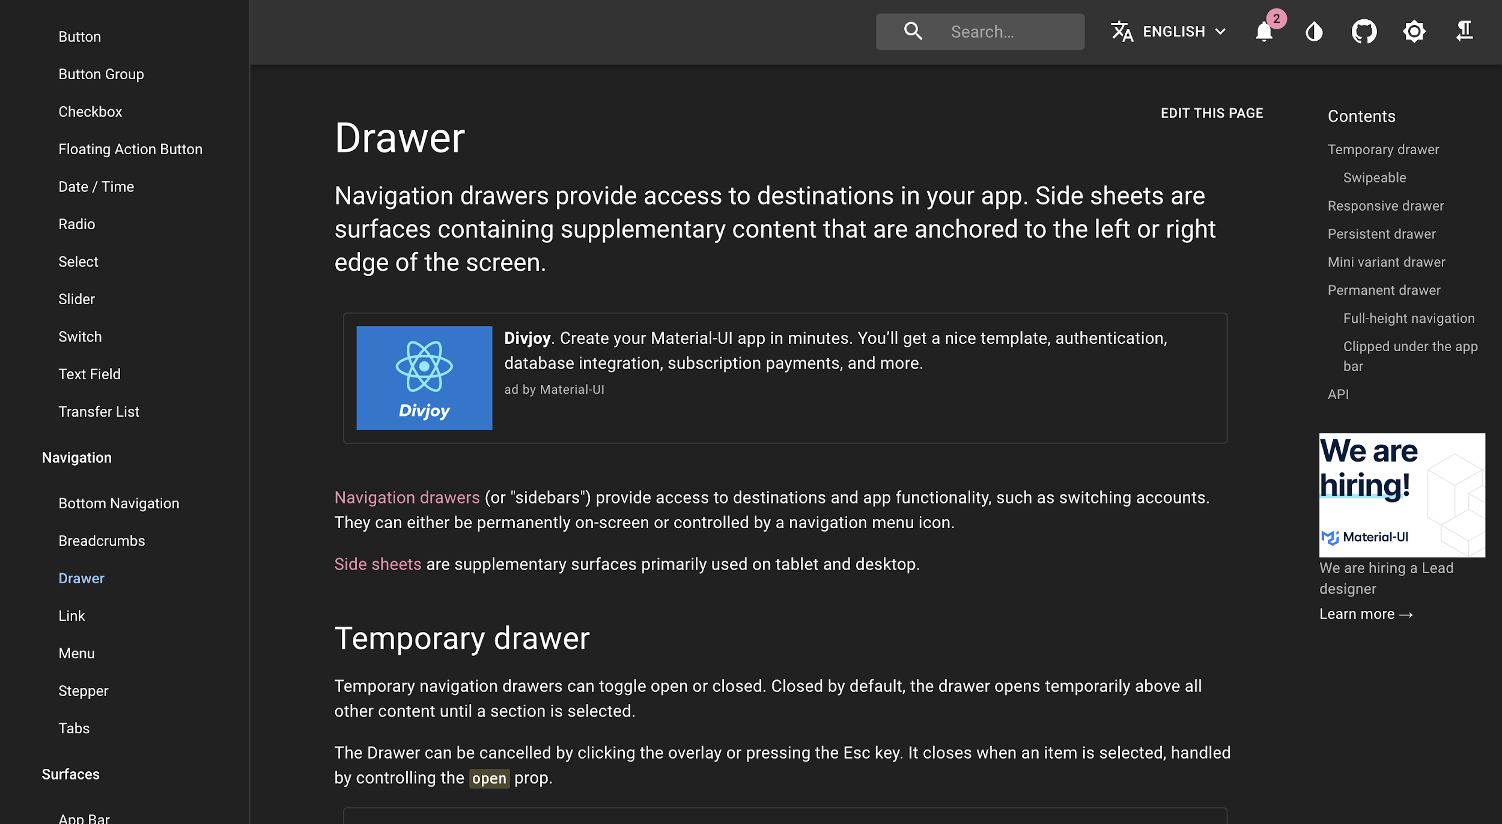
Adaptive Components
Not every webpage can be simple. When yours can’t, make or use adaptive components that scale based on screen size

Slide 6
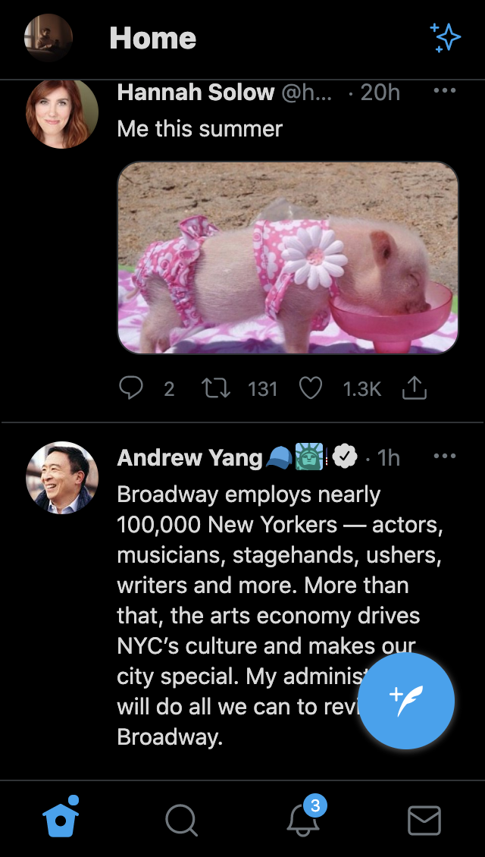
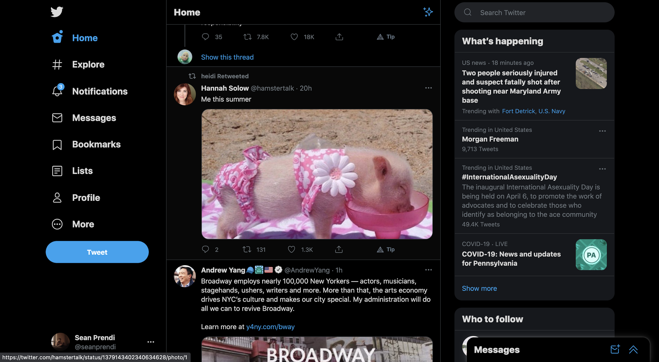
Adaptive Layout
In conjunction with adaptive components, you should make your layout adaptive so that components are placed in different locations depending on the user’s screen size

Slide 7
So How Do You Actually Make This Happen?
Utilize libraries that offer responsive components
Avoid absolute positioning of components
Size components based on “view width” and “view height”
Render component and page styles conditionally based on the screen height : width ratio

Slide 8
Let’s See An Example of Making a Site Responsive
We will make our todo-app responsive using both Geist and some new react techniques

